Slide 1
குறுச்செயலிகள் உறுவாக்க தொழில்நுட்பம்
உத்தமம் செல்பேசிக் கணிமை 2016
5 பிப்ரவரி 2016
தி.ந.ச.வெங்கடரங்கன்
Blog: venkatarangan.com
Twitter: @venkatarangan

Slide 2
Agenda
Why apps?
Decisions?
Case Studies
Questions

Slide 3
Why Apps?

Slide 4
குறுச்செயலிகளின் பயன்பாட்டு எண்ணிக்கை
 | 2011 | 2012 | 2013 | 2014 | 2015 | 2016
Free Apps Downloaded | 22.1 Billion | 40.6 Billion | 73.3 Billion | 119.9 Billion | 189 Billion | 287.9 Billion
Paid Apps Downloaded | 2.9 Billion | 5.0 Billion | 8.1 Billion | 11.9 Billion | 16.4 Billion | 21.7 Billion
Total Apps Download | 24.9 Billion | 45.6 Billion | 81.4 Billion | 131.7 Billion | 205.4 Billion | 309.6 Billion
% of free apps downloaded | 88.4% | 89% | 90% | 91.0% | 92% | 93%

Slide 5
Notes:
http://www.statista.com/statistics/270291/popular-categories-in-the-app-store/

Slide 6
Decisions – Platforms

Slide 7


Mobile App Platforms
Native iOS / Android / Windows
Apache Cordova
Best possible user experience
Mobile Apps with HTML, CSS & Javascript
Target multiple platforms with one code base
Best performance
Widest functionality
Access to all sensors
Individual code base for each platform
Xamarin
Create native iOS, Android, Windows, and Mac apps in C#
Anything you can do in Objective-C, Swift, or Java you can do in C# with Xamarin
Facebook React Native
Build Native iOS & Android Apps with Javascript
Learn Once, Write anywhere

Slide 8
Decisions – Build or Buy?

Slide 9
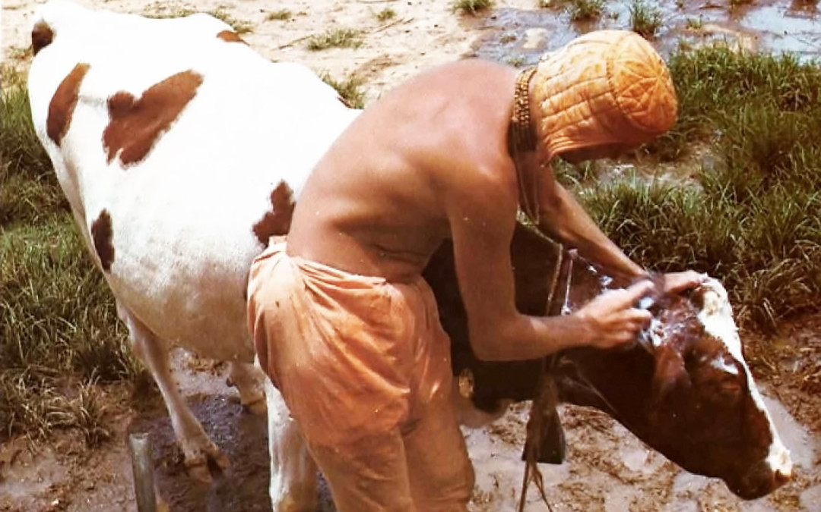
Notes:
சாமியார் பூனை வளர்த்த கதை
http://www.bhagavatam-katha.com/krishna-story-sannyasi-who-got-cat-cow-and-wife/

Slide 10
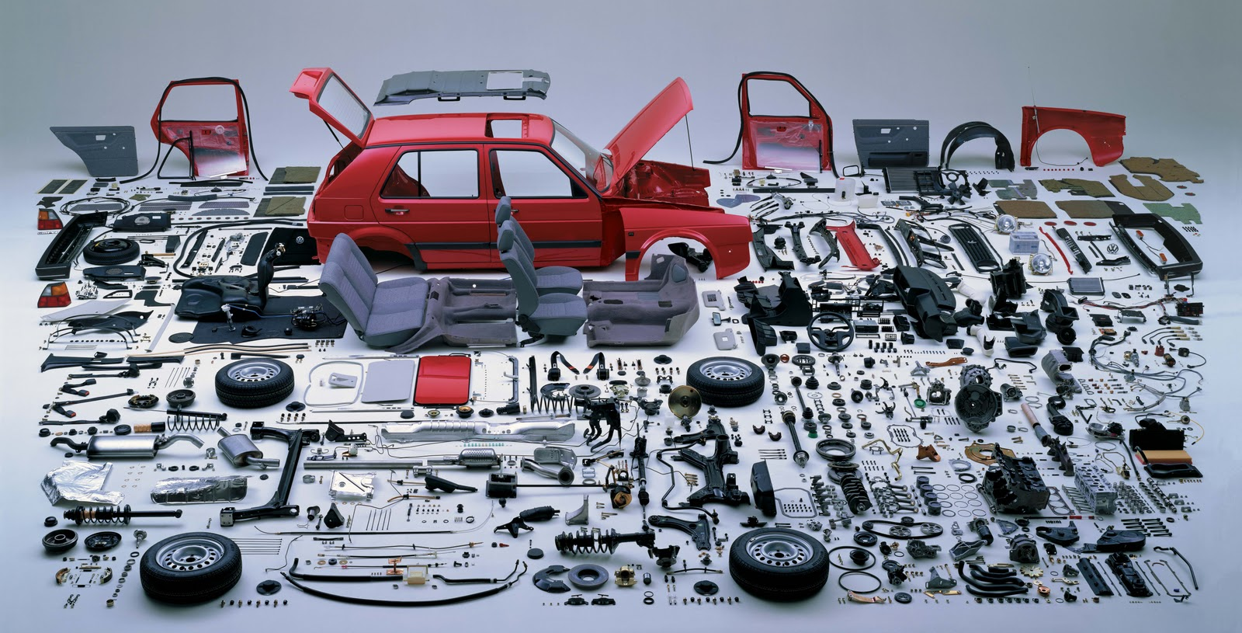
Notes:
Answer is to outsource everything, focus on your core app

Slide 11
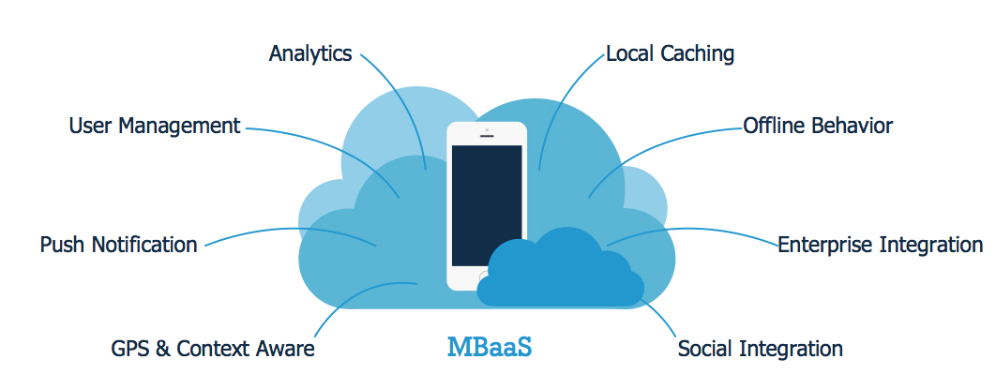
Mobile backend as a service

Slide 12
Case Studies – The choices we made

Slide 13


Tortoise (code name)
Social platform that connects Parents with local coaches
Helps list, schedule lessons, give feedbacks, secure messaging & payments

Slide 14
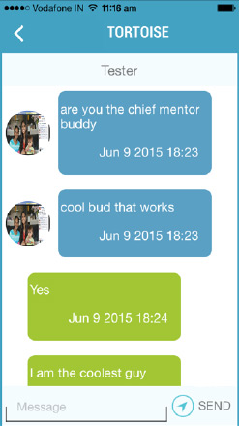
Real time messaging

Slide 15
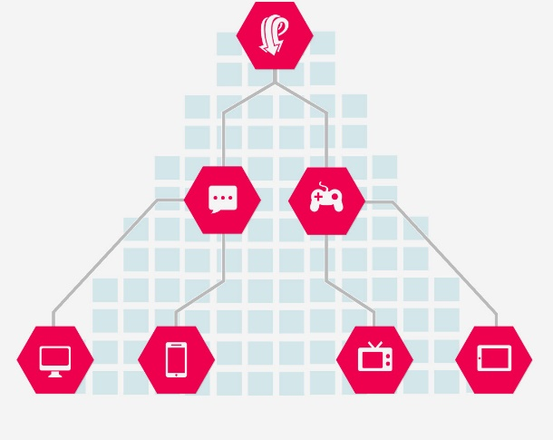
Pusher.com
  Integrate real time messages in your apps
  Instantly update browsers, mobiles and IoT devices
  Presence channels enable you to show the online/offline status
  Secure mechanism for controlling who has access to given channels
  Free & Paid models
PTPusherAPI *api=[[PTPusherAPI alloc]initWithKey:PUSHER_API_KEY appID:PUSHER_APP_ID secretKey:PUSHER_API_SECRET];
pusherAPI=api;
[pusherAPI triggerEvent:@"message_received" onChannel:senderId data:parameterDict socketID:nil];

Slide 16
Payment & Subscriptions

Slide 17
iTunes in-app purchases
[iapHelperObj buyProduct:currentProduct];
if(response.invalidProductIdentifiers.count!=0) // If it is invalid means that product is not yet available.
{
[self showAlertWithText:@"Currently Product Not Available,Please Try Later"];
}
else// If product is valid than start the payment.
{
[subscribeBtn setEnabled:YES];
SKProduct *product = response.products[0];

Slide 18
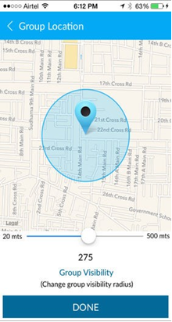
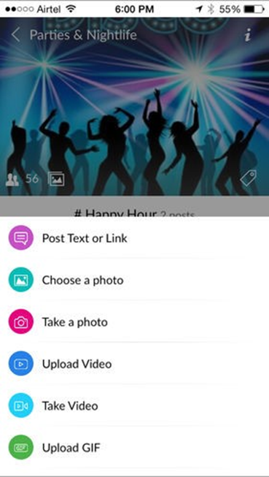
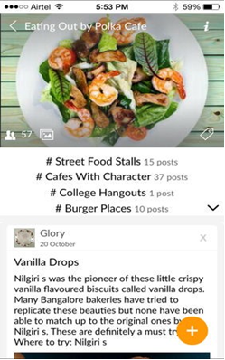
Connect Chat (code name) Application

Slide 19
Connect Chat made possible by integration
Crashlytics
Microsoft Azure
Github
Microsoft Onedrive
Microsoft Office365
Facebook Parse
Digits
Twilio

Slide 20

Facebook Parse
Build apps faster with user management, push notifications, storage and analytics
Forget server maintenance and complex infrastructure
Have one backend for all mobile platforms
Link accounts across networks, resetting passwords
PFQuery *invitesquery =[PFQuery queryWithClassName:@"Invitation"];
[invitesquery whereKey:@"ToUser" equalTo:sharedobj.AccountNumber];
[invitesquery whereKey:@"InvitationStatus" equalTo:@"Active"];
Notes:
Parse object is a dictionary

Slide 21

Digits
Verify your users
Seamless User Onboarding Experience
New confirmation codes are sent securely to users via SMS
Digits.authenticate(authCallback,"+919884098840")
Notes:
Parse object is a dictionary

Slide 22

Twilio
We used Twilio for countries other than India & Whitelist is for India
Twilio
  Messaging, Voice, Video API
  Send and receive global SMS, MMS
  Enable apps to make voice or video calls
public Message SendMessage(string from, string to, string body, params string[] mediaUrl)
{
return _client.SendMessage(from, to, body, mediaUrl);
}
Notes:
Parse object is a dictionary

Slide 23
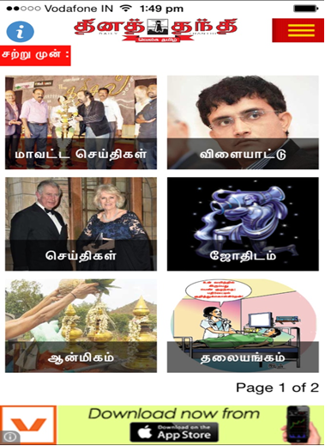
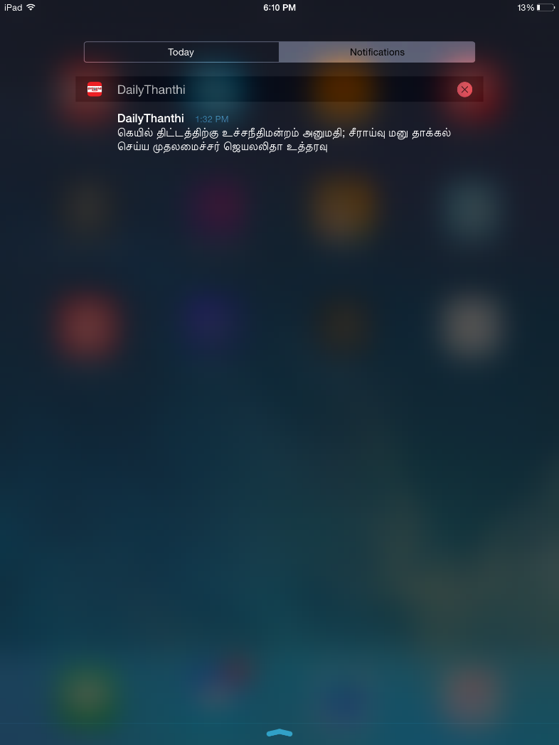
Dailythanthi News App

Slide 24
Amazon Simple Notification Service (SNS)
Access SNS using iOS, Android, Java, Python, PHP, Node.js, or .NET SDKs
Get delivery status information on success rates, failure rate
Similar service will be Microsoft Azure Notification Hubs
Notes:
Parse object is a dictionary

Slide 25
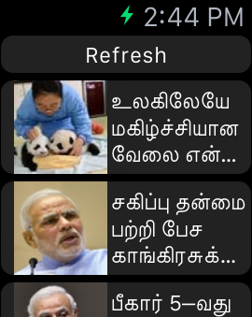

MaalaiMalar Apple Watch

Slide 26
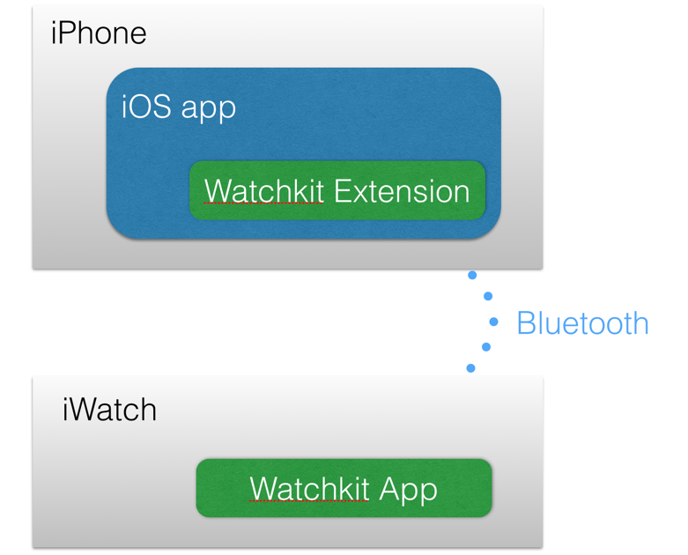
Watch App v1
Watchkit v1 apps don't run on their own
Two parts to a watch app, the extension and the app. App gets pushed to iWatch, while extension remains on the iPhone
[self.newsTableview setNumberOfRows:newsListArray.count withRowType:@"MyRowViewController"];
[newsListArray enumerateObjectsUsingBlock:^(id obj, NSUInteger idx, BOOL *stop)
{ MyRowViewController* row = [self.newsTableview rowControllerAtIndex:idx];
NewsDetailedModalClass *modalObj=[newsListArray objectAtIndex:idx];
[row.myLabel setText: modalObj.headLine];
[row.newsImage setImageData:[NSData dataWithContentsOfURL:[NSURL URLWithString:modalObj.thumbImage]]];
}];
}
(instancetype) contextForSegueWithIdentifier:(NSString *)segueIdentifier inTable:(WKInterfaceTable *)table rowIndex:(NSInteger)rowIndex
{ return [newsListArray objectAtIndex:rowIndex]; }
Notes:
Parse object is a dictionary

Slide 27
நன்றி!

Slide 28
In 2016
important real estate in mobile,
is not the home screen,
it’s the notification bar!
Blog: venkatarangan.com
Twitter: @venkatarangan

