Slide 1


Slide 2

Introduction to Building Applications with Windows Azure
Wednesday 9th Feb 2010. 10:45AM
T.N.C.Venkata Rangan
Chairman, Vishwak Solutions
www.venkatarangan.com/blog

Slide 3





























Customers Live on Windows Azure Platform
http://www.microsoft.com/windowsazure/evidence/

Slide 4
Overview
Windows Azure for Application Developers
Building an Azure Application from Scratch in Visual Studio 2010 Beta 2
Tables, Blob & Queues
Build an application using SQL Azure
Review Application
Wrap Up

Slide 5
Session Objectives
Understand the major parts of Windows Azure
Experience building an application with Windows Azure
Leave feeling confident that you can build your own applications with Windows Azure

Slide 6


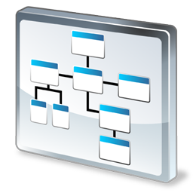

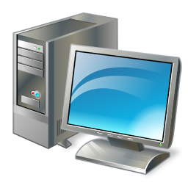

Windows Azure for Application Developers
SDK
Portal
Hosted
Service
Storage
Develop
Deploy
Run

Slide 7


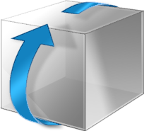
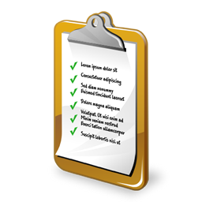
Roles
Role
Code
Configuration

Slide 8


Load Balanced Instances
Role
Instance 1
http://yourapp.cloudapp.net
Instance 2

Slide 9


Web vs Worker Role
Web Role
Worker Role
IIS Host
System Host
Your Code
Your Code

Slide 10


Development Fabric and Storage
Local Machine
Windows Azure Simulation Environment
Development Fabric
Development Storage

Slide 11
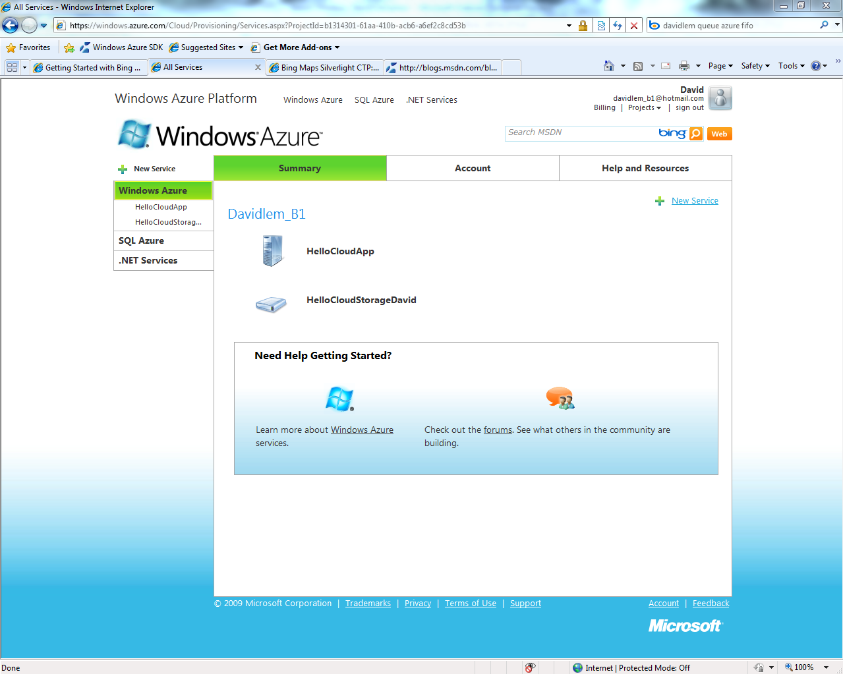
Portal

Slide 12
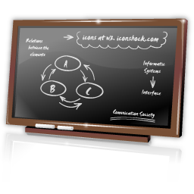
Web Role
Demo

Slide 13

Hello Cloud – Web Role
Web Role

Slide 14
What We’re Going To Code
Step 1 - Create a Cloud Service project with a Web Role
Step 2 - Write our code and test it locally
Step 3 – Deploy to the Cloud

Slide 15
Fundamental Storage Abstractions
Tables – Provide structured storage. A Table is a set of entities, which contain a set of properties
Queues – Provide reliable storage and delivery of messages for an application
Blobs – Provide a simple interface for storing named files along with metadata for the file
Drives – Provides durable NTFS volumes for Windows Azure applications to use (new)
15

Slide 16





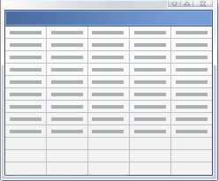
Storage
Storage
Queue
Blob
Account
Tables

Slide 17
Windows Azure Storage Account
User creates a globally unique storage account name
  Can choose geo-location to host storage account
    “US Anywhere”, “US North Central”, “US South Central”,
  Can co-locate storage account with compute account
  Receive a 256 bit secret key when creating account
Storage Account Capacity at
Commercial Availability
  Each storage account can store up to 100 TB
  Default limit of 5 storage accounts per subscription

Slide 18
Create a Storage Account
Demo

Slide 19
Tables

Slide 20
Windows Azure Tables
Provides Structured Storage
  Massively Scalable Tables
    Billions of entities (rows) and TBs of data
    Can use thousands of servers as traffic grows
  Highly Available & Durable
    Data is replicated several times
Familiar and Easy to use API
  ADO.NET Data Services – .NET 3.5 SP1
    .NET classes and LINQ
    REST – with any platform or language
20

Slide 21
Table Storage Concepts
Accounts
Tables
Entities
Email =…
Name = …
Users
Email =…
Name = …
moviesonline
Genre =…
Title = …
Movies
Genre =…
Title = …
21

Slide 22
Table Data Model
Table
  A storage account can create many tables
  Table name is scoped by account
  Set of entities (i.e. rows)
Entity
  Set of properties (columns)
  Required properties
    PartitionKey, RowKey and Timestamp
22

Slide 23
Required Entity Properties
PartitionKey & RowKey
  Uniquely identifies an entity
  Defines the sort order
  Use them to scale your application
Timestamp
  Read only
  Optimistic Concurrency
23

Slide 24
Partitions and Partition Ranges
PartitionKey (Category) | RowKey (Title) | Timestamp | ReleaseDate
Action | Fast & Furious | … | 2009
Action | The Bourne Ultimatum | … | 2007
… | … | … | …
Animation | Open Season 2 | … | 2009
Animation | The Ant Bully | … | 2006
… | … | … | …
Comedy | Office Space | … | 1999
… | … | … | …
SciFi | X-Men Origins: Wolverine | … | 2009
… | … | … | …
War | Defiance | … | 2008
PartitionKey (Category) | RowKey (Title) | Timestamp | ReleaseDate
Action | Fast & Furious | … | 2009
Action | The Bourne Ultimatum | … | 2007
… | … | … | …
Animation | Open Season 2 | … | 2009
Animation | The Ant Bully | … | 2006
Server A
Table = Movies
[Action - Comedy)
Server A
Table = Movies
PartitionKey (Category) | RowKey (Title) | Timestamp | ReleaseDate
Comedy | Office Space | … | 1999
… | … | … | …
SciFi | X-Men Origins: Wolverine | … | 2009
… | … | … | …
War | Defiance | … | 2008
Server B
Table = Movies
[Comedy- Western)
24

Slide 25
Table Operations
Table
  Create
  Query
  Delete
Entities
  Insert
  Update
    Merge – Partial Update
    Replace – Update entire entity
  Delete
  Query
  Entity Group Transaction (new)

Slide 26
Queues

Slide 27
Windows Azure Queues
Queue are performance efficient, highly available and provide reliable message delivery
  Simple, asynchronous work dispatch
  Programming semantics ensure that a
  message can be processed at least once
Access is provided via REST
27

Slide 28
Queue Storage Concepts
Accounts
Queues
Messages
128 x 128 http://...
thumbnailjobs
256 x 256 http://...
sally
http://...
traverselinks
http://...
28

Slide 29
Account, Queues and Messages
An account can create many queues
  Queue Name is scoped by the account
A Queue contains messages
  No limit on number of messages stored in a queue
  Set a limit for message expiration
Messages
  Message size <= 8 KB
  To store larger data, store data in blob/entity storage, and the blob/entity name in the message
  Message now has dequeue count
29

Slide 30
Queue Operations
Queue
  Create Queue
  Delete Queue
  List Queues
  Get/Set Queue Metadata
Messages
  Add Message (i.e. Enqueue Message)
  Get Message(s) (i.e. Dequeue Message)
  Peek Message(s)
  Delete Message
30

Slide 31
How Queue Works
Producers
Consumers
P₂
C₁
1. GetMessage(Q, 30 s) → msg 1
4
0
3
3
0
2
1
2
1
2
1
2
0
1
1
1
1
1
1
1
0
C₂
P₁
2. GetMessage(Q, 30 s) → msg 2
31

Slide 32
How Queue Works
Producers
Consumers
1
1
P₂
C₁
1. GetMessage(Q, 30 s) → msg 1
5. C₁ crashed
4
0
3
0
2
1
1
1
1
2
1
1
3
1
2
6. msg1 visible 30 s after Dequeue
2
1
C₂
P₁
2. GetMessage(Q, 30 s) → msg 2
3. C2 consumed msg 2
4. DeleteMessage(Q, msg 2)
7. GetMessage(Q, 30 s) → msg 1
32

Slide 33
Blobs

Slide 34
Blob Storage Concepts
Account
Container
Blob
PIC01.JPG
images
PIC02.JPG
sally
movies
MOV1.AVI

Slide 35
Blob Features and Functions
Store Large Objects (100s of GBs in size)
Associate Metadata with Blob
  Metadata is <name, value> pairs, Up to 8KB per blob
  Set/Get with or separate from blob data bits
Standard REST Interface
  PutBlob
    Inserts a new blob, overwrites the existing blob
  GetBlob
    Get whole blob or a specific range
  DeleteBlob
  CopyBlob (new)
  SnapshotBlob (new)
  LeaseBlob (new)

Slide 36
Two Types of Blobs Under the Hood
Block Blob
  Targeted at streaming workloads
  Each blob consists of a sequence of blocks
    Each block is identified by a Block ID
  Size limit 200GB per blob
Page Blob (new)
  Targeted at random read/write workloads
  Each blob consists of an array of pages
    Each page is identified by its offset from the start of the blob
  Size limit 1TB per blob

Slide 37
Blob Namespace
Blob URL
http://<Account>.blob.core.windows.net/<Container>/<BlobName>
Example:
  Storage Account – sally
  Container – music
  BlobName – rock/rush/xanadu.mp3
  http://sally.blob.core.windows.net/music/rock/rush/xanadu.mp3

Slide 38
Windows Azure
Content Delivery Network (new)
Scenario
  Frequently accessed blobs
  Accessed from around the world
Desire
  Same experience for users no matter how far they are from the geo-location where the storage account is hosted
Windows Azure Content Delivery Network (CDN) provides high-bandwidth global blob content delivery
    18 locations globally (US, Europe, Asia, Australia and South America), and growing
Blob service URL vs CDN URL:
  Windows Azure Blob URL: http://sally.blob.core.windows.net/
  Windows Azure CDN URL: http://<guid>.vo.msecnd.net/
  Custom Domain Name for CDN: http://events.cohowinery.com/

Slide 39
Tables, Blob and Queue
Demo
Guest Book

Slide 40

Recap – Guest Book
Tables
Web Role
Worker Role
Queue
Blob

Slide 41
Windows Azure XDrive (new)
Provides a durable NTFS volume for Windows Azure applications to use
  Use existing NTFS APIs to access a durable drive
    Durability and survival of data on application failover
  Enables migrating existing NTFS applications to the cloud
A Windows Azure Drive is a Page Blob
  Example, mount Page Blob as X:\
    http://<accountname>.blob.core.windows.net/<containername>/<blobname>
  All writes to drive are made durable to the Page Blob
    Drive made durable through standard Page Blob replication
    Drive persists even when not mounted as a Page Blob

Slide 42
SQL Azure

Slide 43



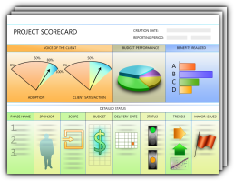
SQL Azure Database
Database
Highly scaled out relational database as a service
Relational database service
  SQL Server technology foundation
  Highly symmetrical
  Highly scaled
  Highly secure
  Database “as a Service” – beyond hosting
Browser
SOAP/REST
HTTP/S
ADO.NET/REST - EDM
HTTP/S
MS
Datacenter
Windows Azure
Compute
App Code
(ASP.NET)
SQL Server Report Server
(on-premises)
Customer Value Props
  Self-provisioning and capacity on demand
  Symmetry w/ on-premises database platform
  Automatic high-availability and fault-tolerance
  Automated DB maintenance (infrastructure)
  Simple, flexible pricing – “pay as you grow”
T-SQL (TDS)
T-SQL (TDS)
SQL Azure
Database
- AD Federation (LiveId /AppFabric AC)

Slide 44
T-SQL Support (full or partial)
Constants
Constraints
Cursors
Index management and rebuilding indexes
Local temporary tables
Reserved keywords
Stored procedures
Statistics management
Transactions
Triggers
Tables, joins, and table variables
Transact-SQL language elements such as
  Create/drop databases
  Create/alter/drop tables
  Create/alter/drop users and logins
  …
User-defined functions
Views

Slide 45
T-SQL Not Supported (v1)
Common Language Runtime (CLR)
Database file placement
Database mirroring
Distributed queries
Distributed transactions
Filegroup management
Full Text Search
Global temporary tables
Spatial data and indexes
SQL Server configuration options
SQL Server Service Broker
System tables
Trace Flags

Slide 46
Demo
Reviewing a SQL Azure Account
Retrieve data from SQL Azure and display

Slide 47
Demo
Setting up certificates for service management
Using Service Management API

Slide 48
Summary
Same Development Tools and Experience
Local and Cloud Based Environments
Rapid Cloud Development, Deployment and Maintenance

Slide 49

Questions?

