Slide 1
Internet of Things
An explosion of connected possibility…
Notes:
Types of Documents: NDA Required (NDA)
Audiences:
AMI employees
AMI customers under NDA
May be posted to password-protected websites for customers
example: AMI Portal
Cannot be distributed as a public document
Examples:
Porting guides
Product roadmaps & technical overviews
Customer training

Slide 2
Disclaimer
This Presentation does not constitute or form part of, and should not be construed as, an offer, invitation or inducement to purchase or subscribe for securities nor shall it or any part of it form the basis of, or be relied on in connection with, any contract or commitment whatsoever. This Presentation does not constitute either advice or a recommendation regarding any securities. The communication of this Presentation is restricted by law; it is not intended for distribution to, or use by any person in, any jurisdiction where such distribution or use would be contrary to local law or regulation. “The opinions expressed in this presentation and on the following slides are solely those of the presenter and not necessarily those of AMI. AMI does not guarantee the accuracy or reliability of the information provided herein.”
Before acting on any information you should consider the appropriateness of the information having regard to these matters and any relevant offer document and in particular,
For Additional Information
Call American Megatrends, Inc. at 1-800-828-9264 for additional information.
Limitations of Liability
In no event shall American Megatrends be held liable for any loss, expenses, or damages of any kind whatsoever, whether direct, indirect, incidental, or consequential, arising from the design or use of this product or the support materials provided with the product.
Limited Warranty
No warranties are made, either express or implied, with regard to the contents of this work, its merchantability, or fitness for a particular use. American Megatrends assumes no responsibility for errors and omissions or for the uses made of the material contained herein or reader decisions based on such use.
Trademark and Copyright Acknowledgments
Copyright ©2015 American Megatrends, Inc. All Rights Reserved.
American Megatrends, Inc., 5555 Oakbrook Parkway, Building 200, Norcross, GA 30093, USA
All product names used in this publication are for identification purposes only and are trademarks of their respective Companies.

Slide 3

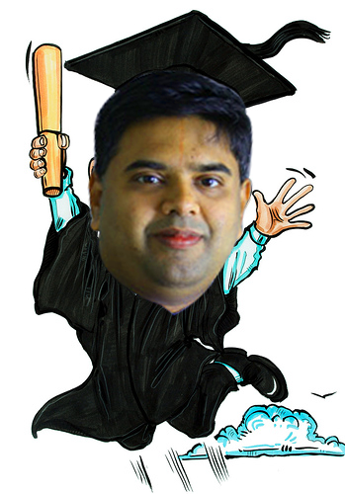
The presentation is not about…
SoC,Products & tools used in this space..
Selling AMI products & Services..
By any means Sridharan Mani is not an expert in this subject and is a learner, who keeps exploring like you.
This is a knowledge sharing session with our experiences in IOT

Slide 4
New Paradigm – As we evolve
We want to be more aware of the environment and predict the outcomes.
We want to minimize surprises and be more realistic in approach.
We need the information reaching our fingertips faster and not willing to wait on reports for days.
We want to be more proactive than reactive.
We believe in prevention than waiting for cure.
We prefer to avoid disaster through proper planning than do firefighting.
“In short we want everything within us and around us to effectively communicate with us to help us lead a better lifestyle” → Enter IOT

Slide 5
Internet Of Things
“The Internet of Things (IoT) is an environment in which objects, animals or people are provided with unique identifiers and the ability to transfer data over a network without requiring human-to-human or human-to-computer interaction.” – Source: WhatIs.com
YES, THINGS DO TALK NOW !!!

Slide 6
What makes IOT possible?
Sensors
Wireless
Internet
Big Data
  Distributed Computing
  Distributed Data (structured/unstructured) – Resilient Distributed Datasets
Advanced Machine Learning & Analytics

Slide 7
IOT Concept Examples

Slide 8
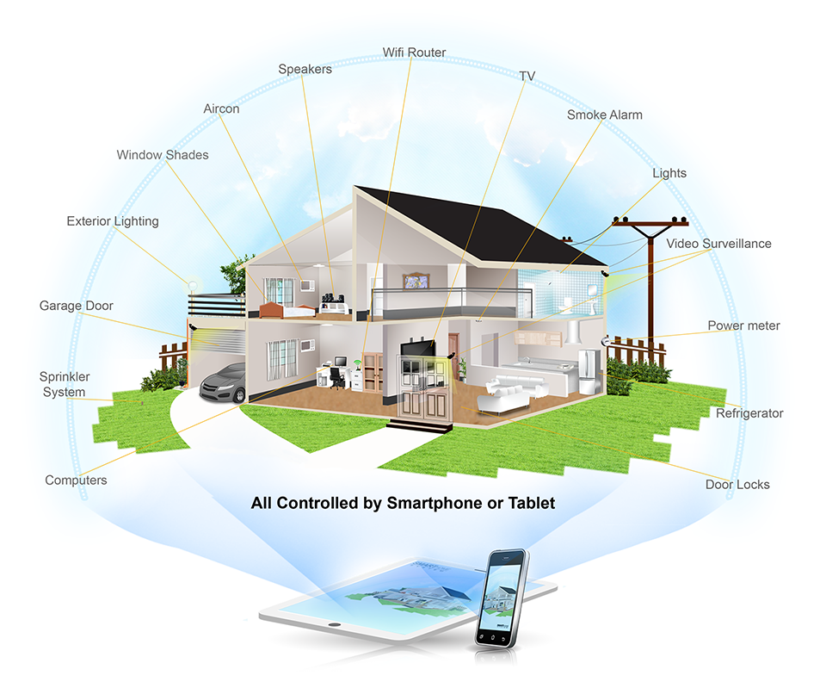

Slide 9
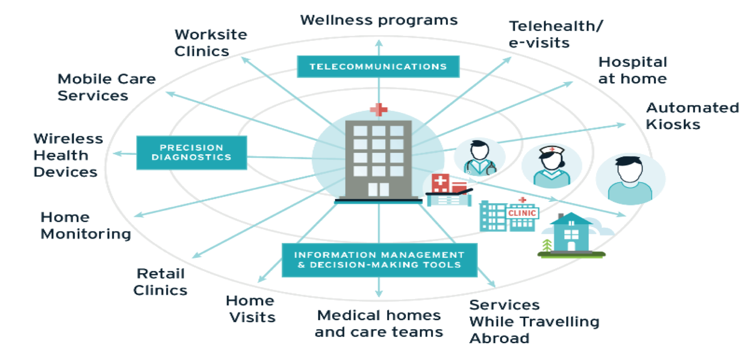
Smart Hospitals: Transforming Health towards decentralized and connected care
Population Health
Disease Map
Prevention Programs

Slide 10
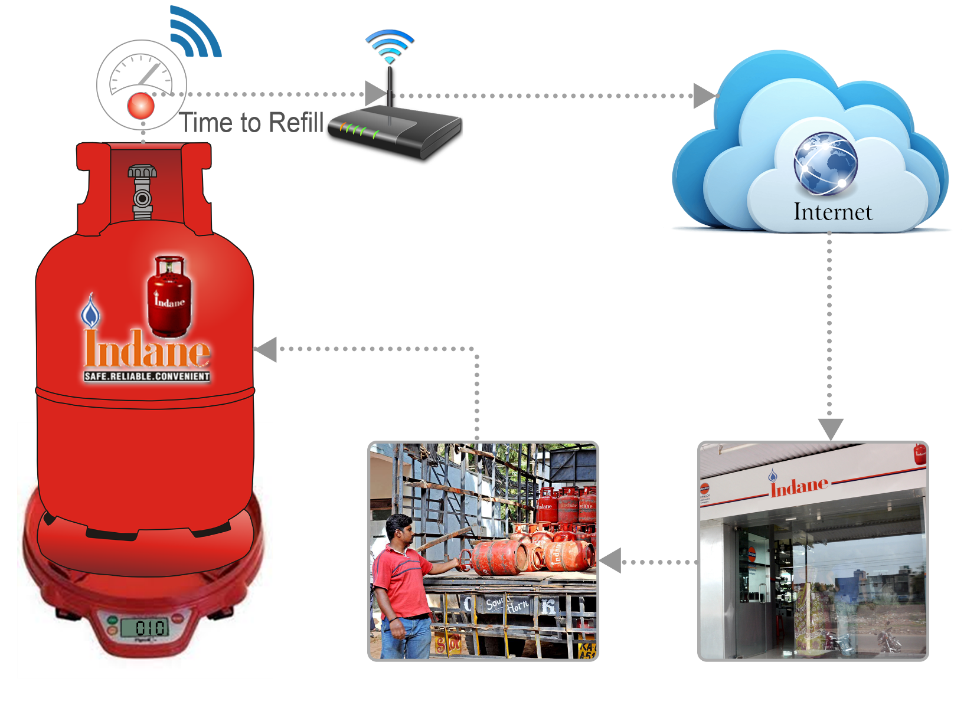
LPG Gas Refilling – Supply Chain

Slide 11
Why IOT?

Slide 12
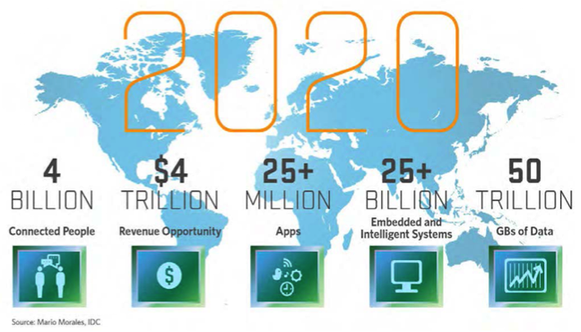
Why IOT is important?
By 2020, IOT will have achieved “Critical Mass”.
Linking enormous intelligence in the cloud to billions of mobile devices and having extremely inexpensive sensors and tags embedded in and on everything, will deliver an enormous amount of new value to almost every human being.
The full benefit in terms of health, safety and convenience - will be enormous.
- Source: IDC

Slide 13
IOT Components

Slide 14
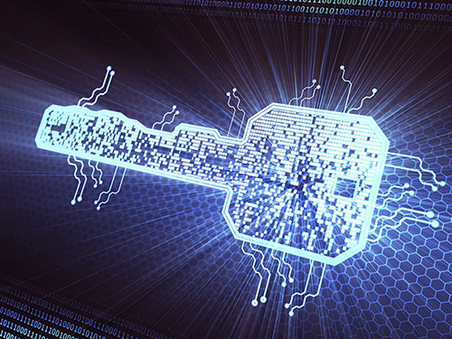
A Quick word on Sensors..

Slide 15
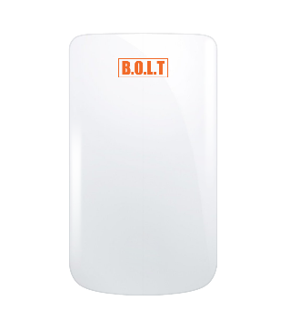
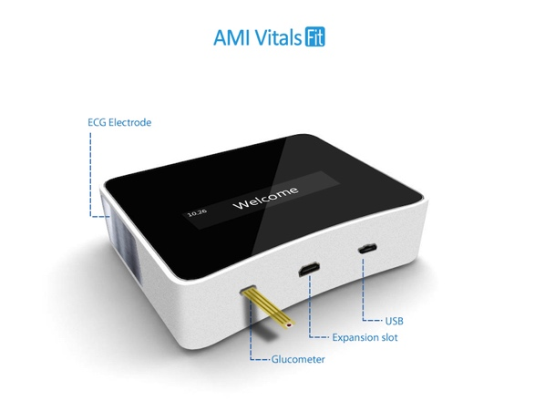
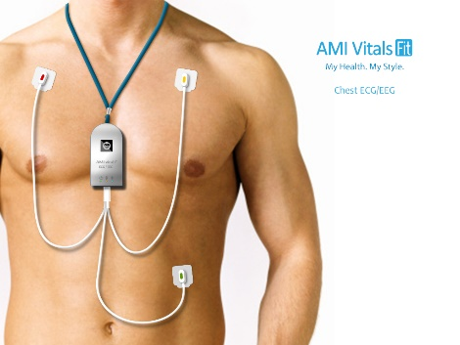
Challenges in Developing Domiciliary Based e-Enabled Accurate Measuring Devices
The challenges faced in developing Clinically accurate Consumer affordable IOT devices can be classified into following:
  Design related challenges
    Analog Circuit design – signal detection in milli and micro volts
    Photometric – detecting low perfusion signals
    Power Circuit – low power consumption, earth bonding and leakage protection
    Radiation Hazards – harmful radiation control
    Miniaturization – should be portable, selection of components meeting the budget
    Operating Conditions – Device safeguards itself from dust, heat and non-conductive operating environment
  Conformance to Standards – CE, AAMI, ISO, BHS, FCC, FDA
  Manufacturing Process and Quality Assurance – ISO 13485
  Device Costing

Slide 16
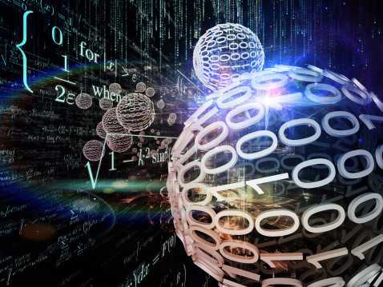
ALGORITHMS

Slide 17
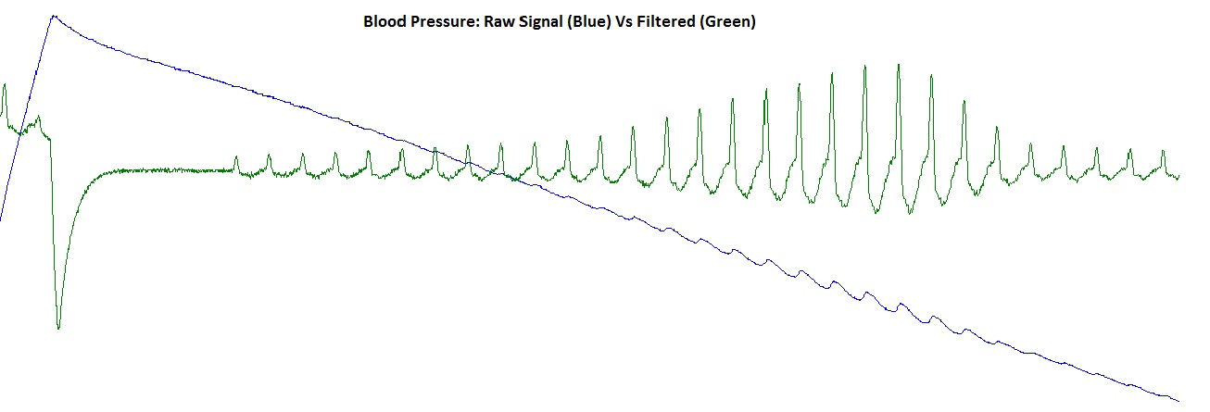
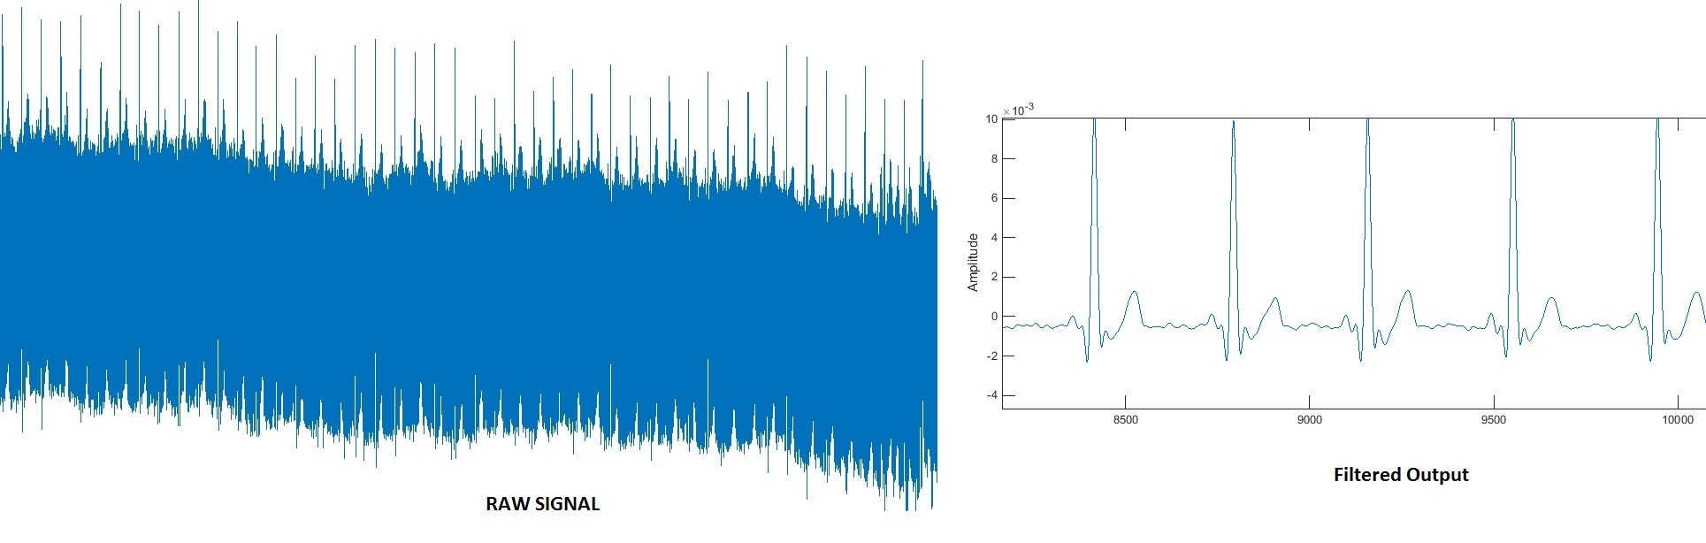
Some real-world examples… (Raw / Filtered)

Slide 18
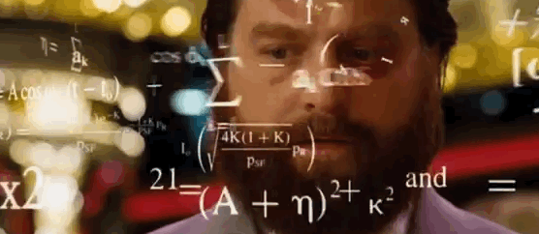
ALGORITHMS
It is key aspect of IOT… HERE THERE EVERYWHERE.... MATHS, MATHS & More MATHS...
Some Examples:
Routing & Searching – Dijkstra, A-Star
SNR: Noise Reduction & Cancellation:
    Filters – FIR (Finite Impulse Response), IIR (Infinite Impulse Response), Fourier,…
    Curve Fitting (, Hilbert, Gaussian, Trust Region)
    Transformation (Fourier, Hilbert, …)
    Adaptive Noise Cancellation Techniques
Domain Specific:
    Healthcare – Blood Pressure, Blood Oxygen, ECG, Respiration Rate, PTT, …
    Photometric – k-nearest neighbour, color balacing & saturation, grayscale, cropping, scaling, filtering,...

Slide 19
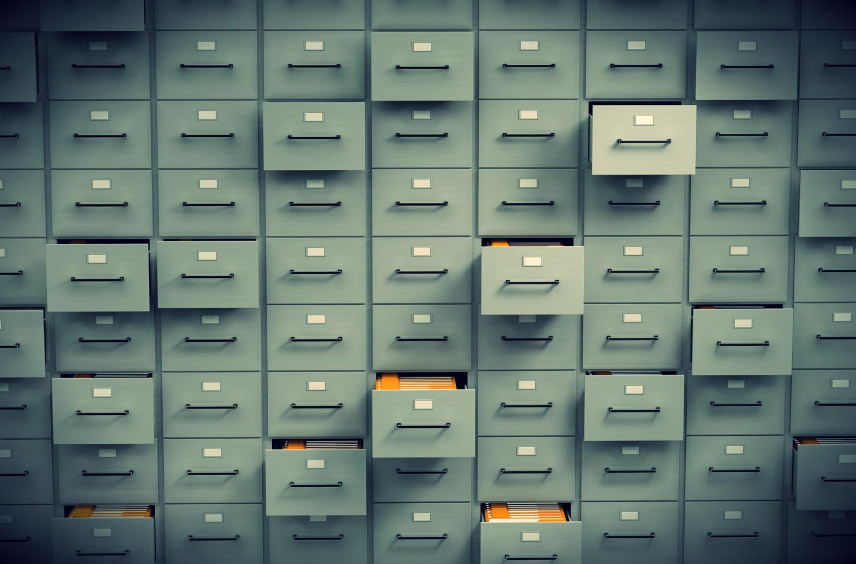
DATA MANAGEMENT

Slide 21
Big Data
“Big data” encompass a wide range of the tremendous data generated from various sources such as mobile devices, digital repositories, and enterprise applications.
The data can be structured as well as unstructured.
It ranges from terabytes—10^12 bytes—to even exabytes—10^18 bytes.
Facebook (FB) gets ~10 million new photos uploaded every hour and Google (GOOG) processes over 24 petaBbytes of data every day.
Twitter (TWTR) tweets ~400 million tweets per day.
Source: http://marketrealist.com/2014/07/traditional-database-systems-fail-support-big-data/

Slide 22
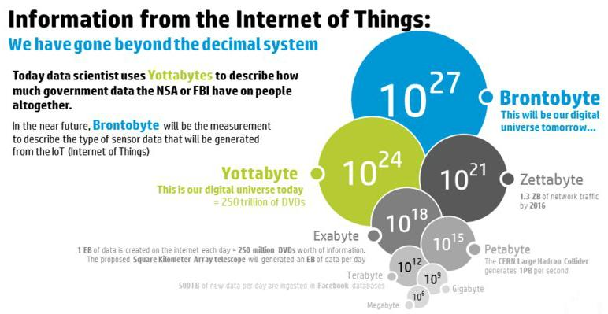
IOT data projections

Slide 23
Why Traditional databases won’t work?
Data Velocity
Data Variety
Data Volume
Large data size (TBs to PBs)
Speed, Change & Processing Requirements
Structured, Unstructured
Diverse Data Sources
Handling high volume of data even with storage table partitions becomes difficult.
Data is from varied sources like email, tweets, news articles, notes, etc.. Hence, putting structure for everything is not possible. RDBMS has inherent weakness in handling text & blob data
Velocity is a key issue, RDBMS are targeted for retention & atomicity than for rapid growth.

Slide 24
A word on distributed database & computing…
World moves too fast and weird types of data gets generated which does not allow a organization to spend 6 months writing a SQL schema for a problem and changing it every week (ex: Medical data from an IOT device).
Enter NoSql databases with its schema-less design, ability to store in-memory data structures of the application directly, works very well on clusters and the ability to encapsulate databases with application and web-services.
In most cases the data needs to be processed as and when it comes into the server (ex: Geofence alert for a Vehicle).
Enter streaming connectors (Apache Storm/Spark streaming) which allows the ability to process data from multiple IOT devices in real-time across distributed data processing clusters

Slide 25
Analytics – Machine Learning
DATA TO ACTIONABLE REPORTS (Knowledge/Wisdom)

Slide 26
Analytics and Machine Learning …
What is Machine Learning? Ability of computers to learn and solve problems.
When to use Machine Learning? If writing a series of ‘if-else’ loops does not solve a problem.
How it works? To simplify, in general Machine learning models have something called as classifier. The classifier in-turn is nothing more than some form of gradient decent function tied with a probability distribution curve to figure out if a new data fits within one of many possible conditions based on training data.
What is Analytics ? Taking some data and making value out of the same.
Types of Analytics: Descriptive, Predictive, Sentiment and Prescriptive. Except for descriptive analytics, other types would generally use some Machine learning algorithm.
Have you used it anywhere except for Social networks? Quite a few like Health Diagnosis, Pedometer.. etc.

Slide 27
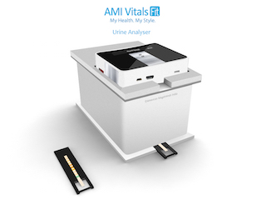


IOT – SPARK – MACHINE LEARNING
Spark, Cloud, Machine Learning
Aggregator (Android based Phone/Tablet)
Runs Application with AMI Vitals SDK
Gets the Images from VitalsFit Device
Sends to Cloud for Machine Learning to detect conditions
Runs algorithm to identify diseases
Apache Spark – Cluster Computing
Big Data, Analytics
Machine Learning Algorithm to detect Urine Analyzer Conditions
AMI VitalsFit (IOT Sensor)
Customized Linux running on Arm Processor
Takes Picture of Urine Sample on the strip for detecting conditions

Slide 28
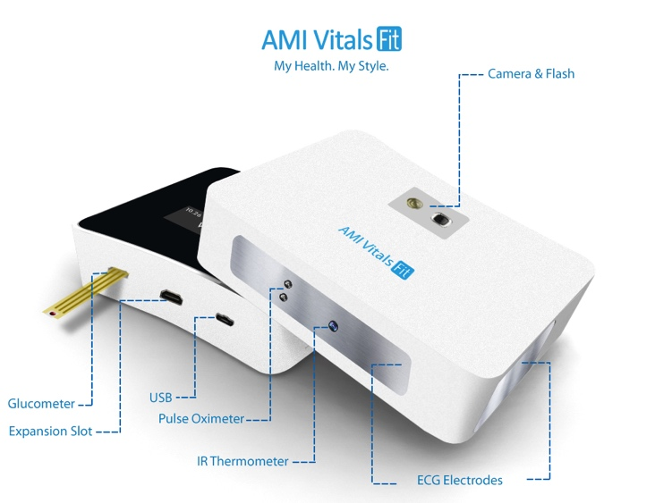
Example – Heart Condition detection….
    AMI VitalsFit device measures the users ECG waveform using a set of electrodes.
    Just displaying the raw waveform is not really useful for anyone except doctors.
    The software needed the ability to detect conditions like Atrial Fibrillation(Afib) which is a type of common heart attack needing immediate attention. How to detect with a varying baselines, noises and interference ?
    At the same time false positives should be minimized as low as possible though given a choice it is better to have a false positive than a false negative. How to decide ?
    Principle component analysis (PCA) based machine learning techniques and Extreme machine learning models (ELM) to detect Afib which showing a marked improvement in accuracy from 10% to 70% and improving.

Slide 29
AMI’s IOT Framework

Slide 30
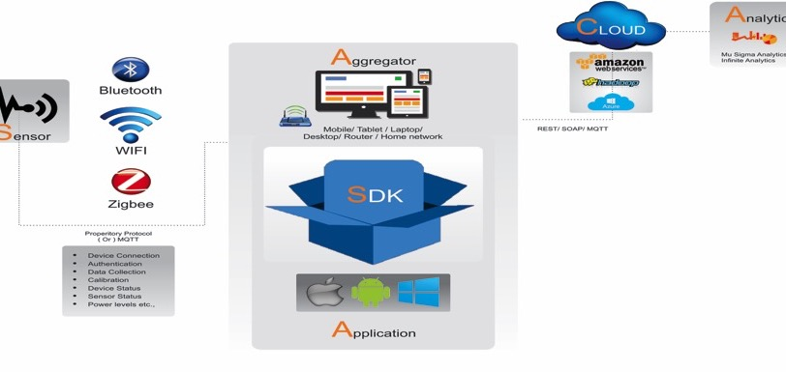
AMI’s IOT Framework: SA-SA-CA Model

Slide 31
Skills required
Why Math ? No classifiers would be a prefect fit for a problem. Looking under the hood so to speak and tweak/tune would be required for any problem.
What Math ? Set Theory, Multivariable Calculus, Trigonometry, Linear Algebra, Probability and Statistics.
Python (Scikit Learn)/Matlab (Statistics and Machine Learning Toolbox) for prototyping, Java/Scala for production systems.
Good knowledge on Image Processing, Algorithms development, Spark and NoSQL databases.

Slide 32
Final thoughts…
Sensors are still advancing… Good market opportunity exists here...
R&D requires time and money commitments. Cannot get it right the first time.
It is not about learning a programming language, it is more to do with understanding the fundamentals in mathematics, science & the chosen domain
More analytical in nature, need Data Scientists and Analysts…
India has edge with the maximum number of students with Science & Mathematics background. Indian talent could lead the next wave in the digitial era by radical innovations. We tried to do it and we believe you can too.
There is no need for large infrastructure to start learning IOT, Big Data & Cloud. Could start with a simple installation of Spark & Anaconda in your local systems.

Slide 33
AMI Corporate Background

Slide 34
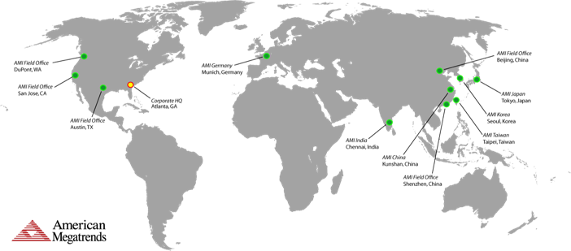
Global Network
United States:
  Norcross, GA (Headquarters)
  San Jose, CA
International:
  Kunshan, China
  Beijing, China
  Shenzhen, China
  Munich, Germany
  Chennai, India
  Tokyo, Japan
  Seoul, Korea
  Taipei, Taiwan
Over 25 Years of Shaping the Industry
Notes:
Confidential Material
2/26/2016
©2007 American Megatrends Inc.
34
Copyright 2007
Confidential Presentation
34

Slide 35
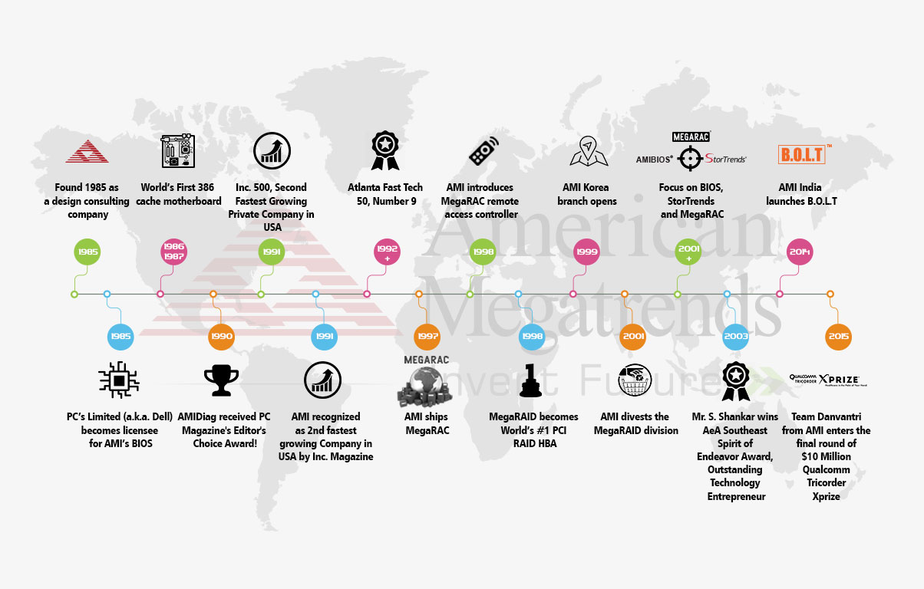
AMI over the Years:
Notes:
AMI developed MegaRAID® - the most widely shipped RAID controller in the world from 1996 to 2001*

Slide 36
Questions / Feedbacks ?

